Slide 1
STATE LIFE CAFÉ & CANTEEN
SOCIAL PHOTOGRAPHY DECK | 1:1 • 4096 × 4096
Client: A.S.S Sab.
State Life Café & Canteen
State Life Building 01
MESA

Slide 2
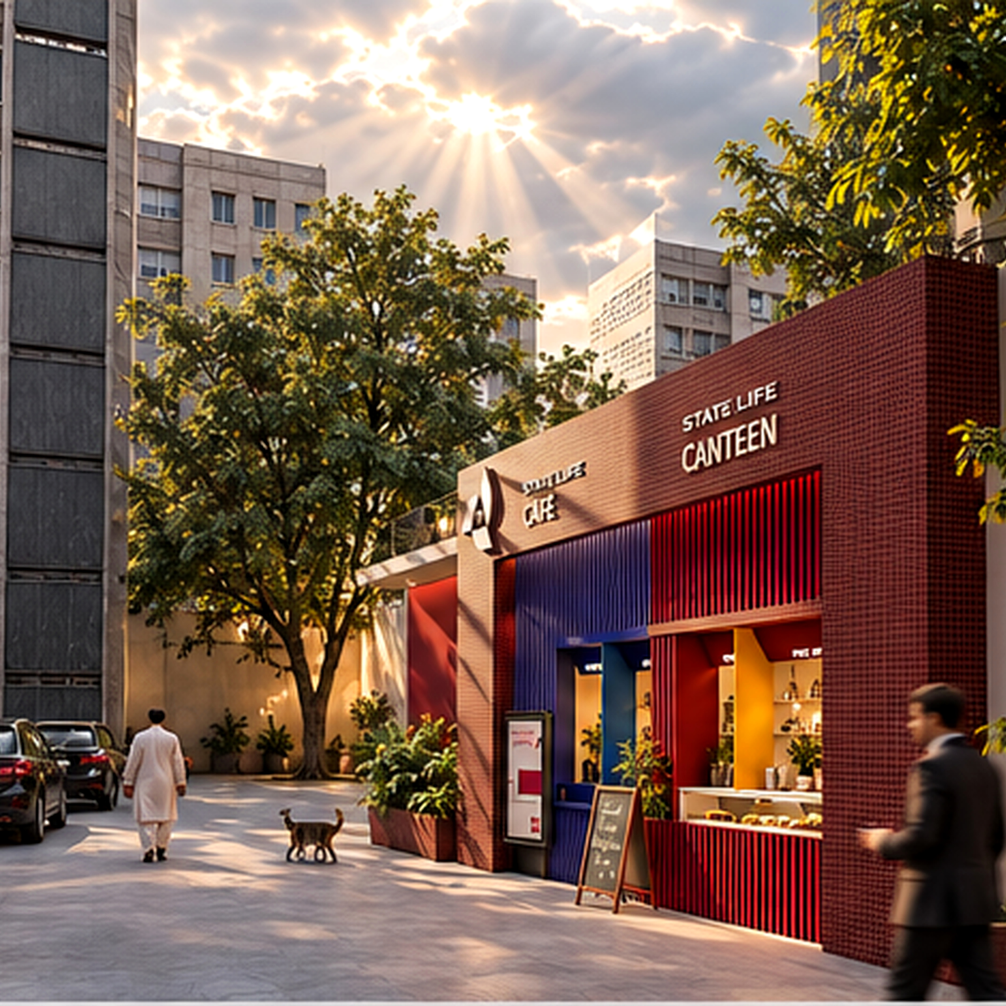
FRIDAY EVENING
Arrival / Approach
A familiar corner, reimagined.
The approach introduces the café as a bright civic pause within State Life Building 01. The tiled portal, colour-coded counters and mature urban landscape make the intervention immediately legible.
Intent: introduce the project through context and arrival. Keep architecture on the right third, with the urban approach and sky establishing place.
Suggested format: Instagram / LinkedIn square post • 4096 × 4096
Client: A.S.S Sab.
State Life Café & Canteen
State Life Building 01
MESA

Slide 3
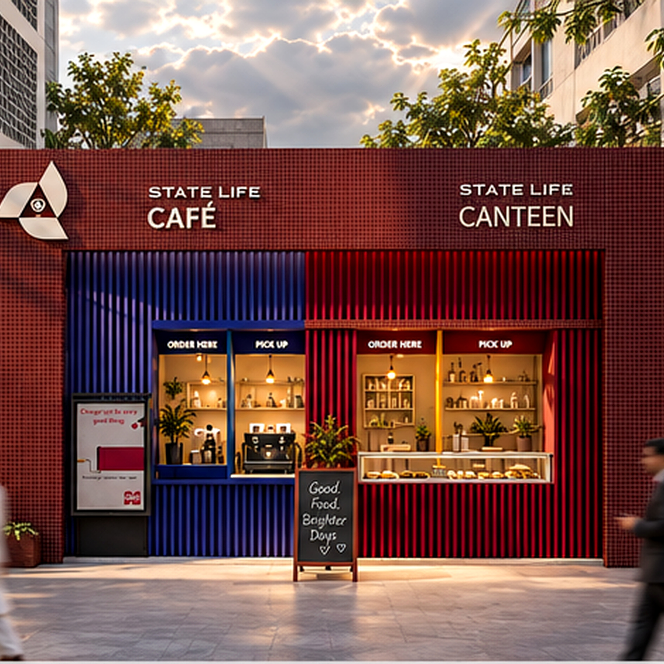
SUNDAY EVENING
Front Elevation
Distinct, yet familiar.
A clear façade hierarchy separates café and canteen functions while a shared material language ties them together. Burgundy, blue and warm yellow make ordering points easy to read without losing the building’s institutional character.
Intent: communicate design clarity, identity and material contrast. The façade remains the hero; people provide scale rather than becoming the subject.
Suggested format: Instagram / LinkedIn square post • 4096 × 4096
Client: A.S.S Sab.
State Life Café & Canteen
State Life Building 01
MESA

Slide 4
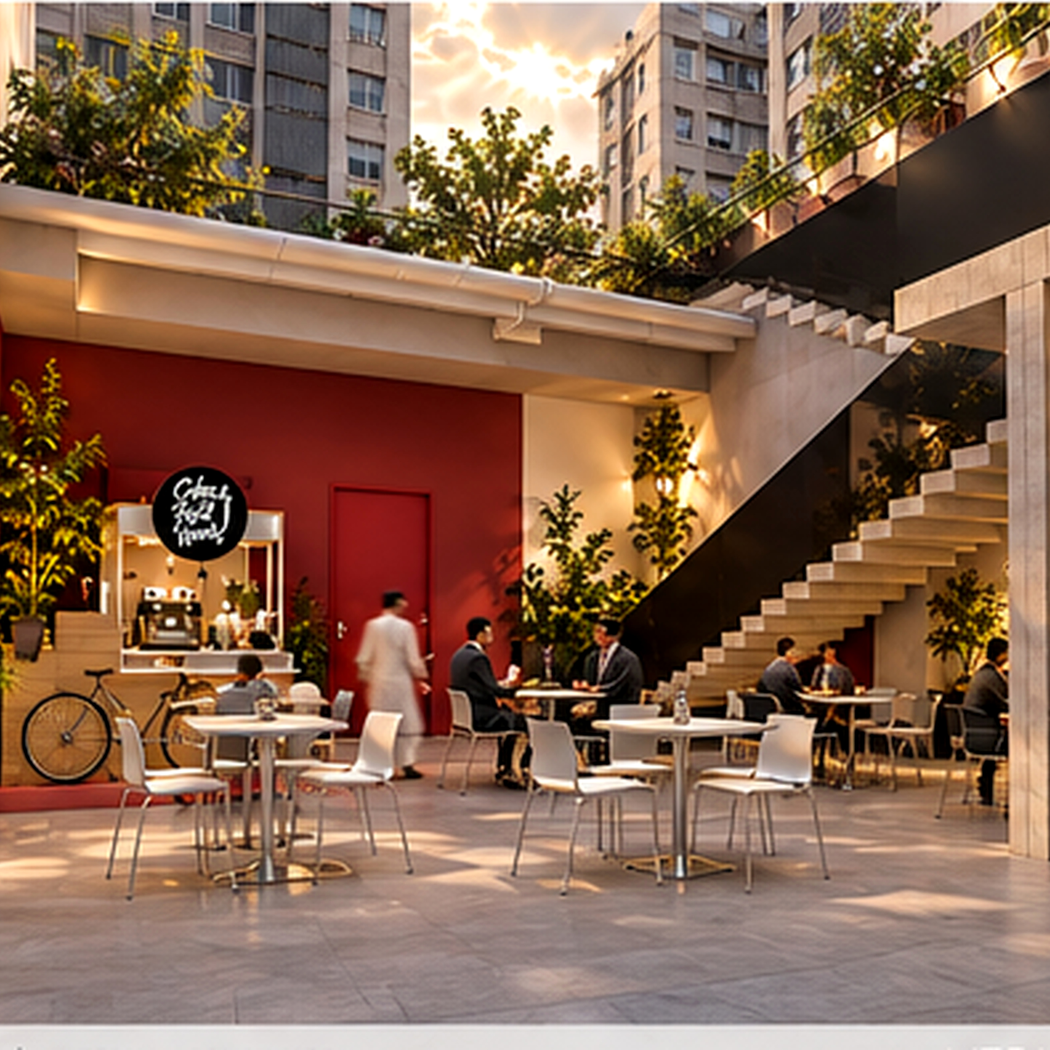
TUESDAY EVENING
The Courtyard
A space to pause.
Behind the service frontage, the courtyard becomes a shaded social room: open, calm and connected. Existing structure, new seating, planting and warm light work together to create an everyday place for conversation and coffee.
Intent: show experience and occupation. Seating and people sit around the lower thirds while the stair and canopy frame the space.
Suggested format: Instagram / LinkedIn square post • 4096 × 4096
Client: A.S.S Sab.
State Life Café & Canteen
State Life Building 01
MESA

